Slide 1
CSC 430 Database Management System Project
Michael Towns
Chris
Sanders

Slide 2
Area of Application
Primary Purpose:
This database and management system allows a user to see what insurance agencies are accepted at a given medical institution, as well as the location and operating hours of the institution.
Secondary Purpose:
The user will be able to see a list of medical practitioners that work in a certain institution.
The user will also be able to rate and review a medical institution and/or a medical practitioner.
Notes:
Steven
Multiple optometrists

Slide 3
Challenges
Current Data Storage:
Websites
Hours
Contact Info
Practitioners
Insurance
Crowdsourcing:
Initial lack of data
Will take time to build collection
Self-sustaining
Benefits:
Speed
Ease of Use
Multipurpose
Accessible
Expandable
Notes:
Chris

Slide 4
Entities
User
User_ID
Unique ID generated on creation
SSN
Insurance Provider
InsuranceProvider_ID
Unique ID generated on creation
Practitioner
HP_ID
Unique ID generated on creation
Institution
HP_ID
Unique ID generated on creation
Notes:
Steven

Slide 5
Relationships
Rates
User Rates Health_Provider
Degree: 2
Attributes:
Rating
Score
Covers
Insurance Covers User
Degree: 2
Attributes:
Policy_No
 | User | Health_Provider
Cardinality | N | N
Participation | 0 | 0
 | Insurance | User
Cardinality | N | N
Participation | 1 | 0
Notes:
Chris

Slide 6
Relationships, continued
Accepts
Health_Provider Accepts Insurance Provider
Degree: 2
Employs
Institution Employs Practitioner
Degree: 2
 | Health_Provider | Insurance_Provider
Cardinality | N | N
Participation | 1 | 0
 | Institution | Practitioner
Cardinality | N | 1
Participation | 1 | 0
Notes:
Chris

Slide 7
Constraints
A User can be Covered by no more than one Insurance Provider, but an Insurance Provider must cover at least one User.
A Health Provider must accept at least one Insurance Provider, but an Insurance Provider can be accepted by many Health Providers or by none.
A User can rate many Health Providers or none, and a Health Provider can be rated by many Users or by none.
A Health Provider encompasses Institutions and Practitioners. These entities are disjoint. A Health Provider must be either an Institution or a Practitioner.
An Institution must employ at least one Practitioner, but a Practitioner can only be Employed by one Institution or by none.
Notes:
Chris

Slide 8
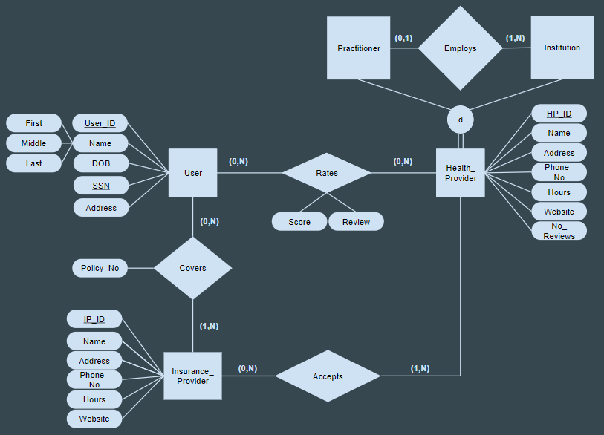
Old Entity/Relationship Model
Notes:
Steven

Slide 9
New Entity/Relationship Model
Notes:
Steven

Slide 10
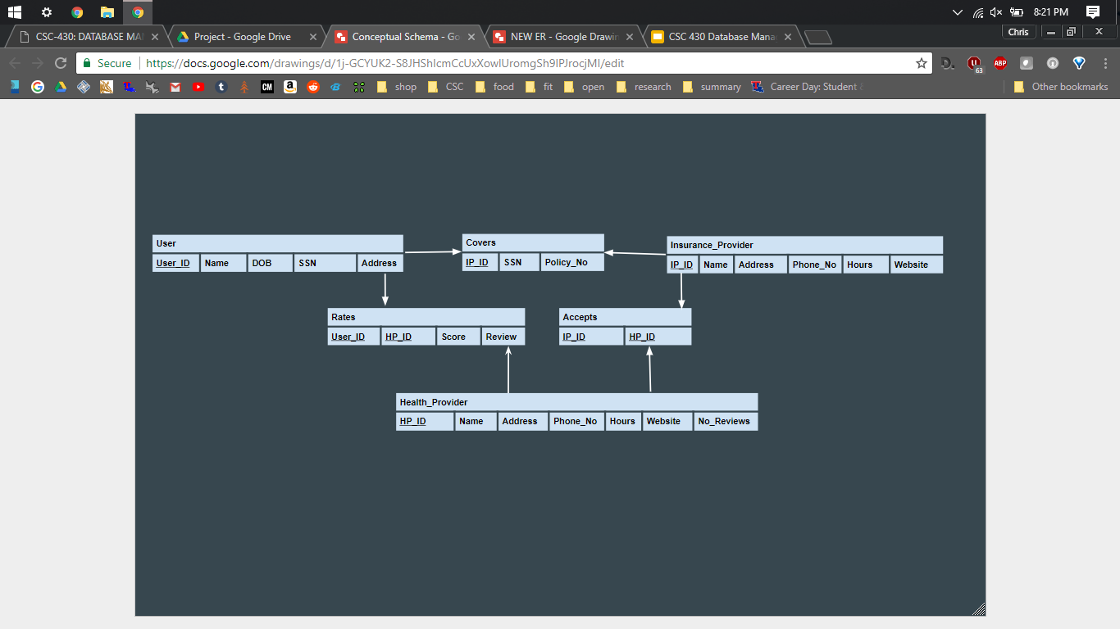
Conceptual Schema
Notes:
Steven

Slide 11
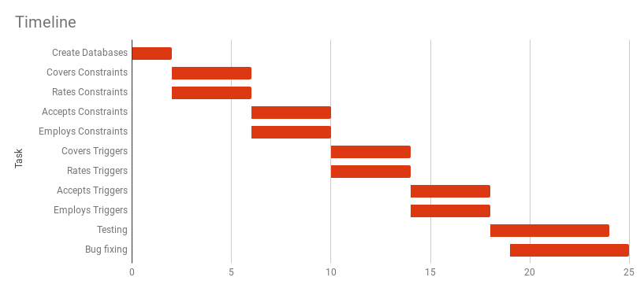
Timeline
Notes:
Steven

Slide 12
CSC 430 Database Management System Project
Michael Towns
Chris
Sanders

